Slide 1
BIKE-SHARING
DATA ANALYSIS
Usage patterns across dates, hours, and rider types
307 records | 28 Jan 2011–14 Feb 2011

Slide 2
Dataset at a glance
Summary statistics for the supplied rows
Records
Dates
Total rides
Avg. per record
307
18
22,977
74.8
• Time coverage in this excerpt: 28 Jan 2011 to 14 Feb 2011
• Time fields: date, hour, weekday, working-day flag, and holiday flag
• Environmental fields: temperature, feels-like temperature, humidity, and windspeed
• Outcome fields: casual riders, registered riders, and total count
Source: supplied data excerpt | Slide 2

Slide 3
Data structure & preparation
The provided markdown table contains 16 fields and no header row
• Parsed pipe-delimited rows into 16 fields
• Converted date strings to date values and TRUE/FALSE to Boolean values
• Converted count fields and category codes to numeric values
• No missing-value imputation or outlier removal was applied
• Field names were inferred from the order and values; confirm against the original dataset before formal publication
Source: supplied data excerpt | Slide 3

Slide 4
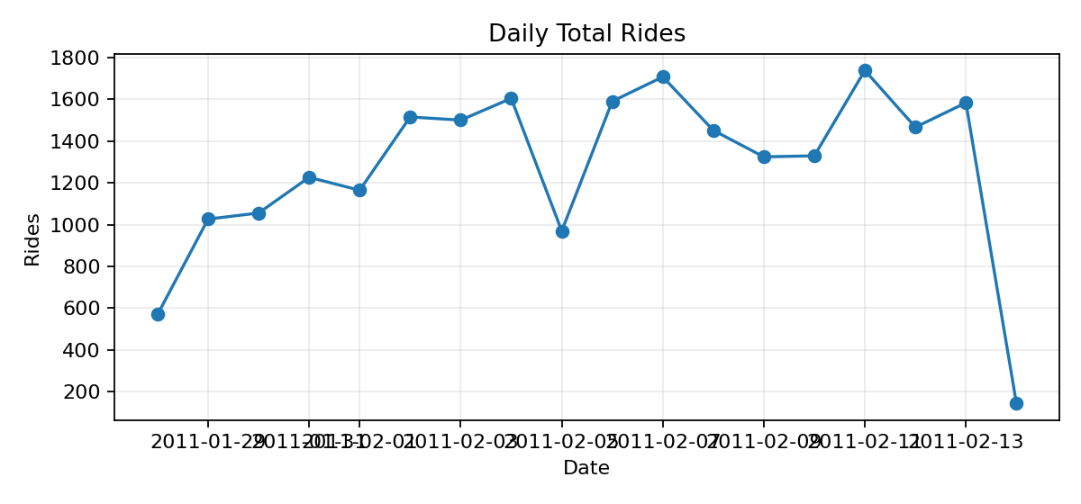
Daily ride volume
Daily sums of the total-count field in the supplied excerpt
• Highest daily total: 1,739 rides
• Peak date: 11 Feb 2011
• Daily totals vary across this short excerpt
Source: supplied data excerpt | Slide 4

Slide 5
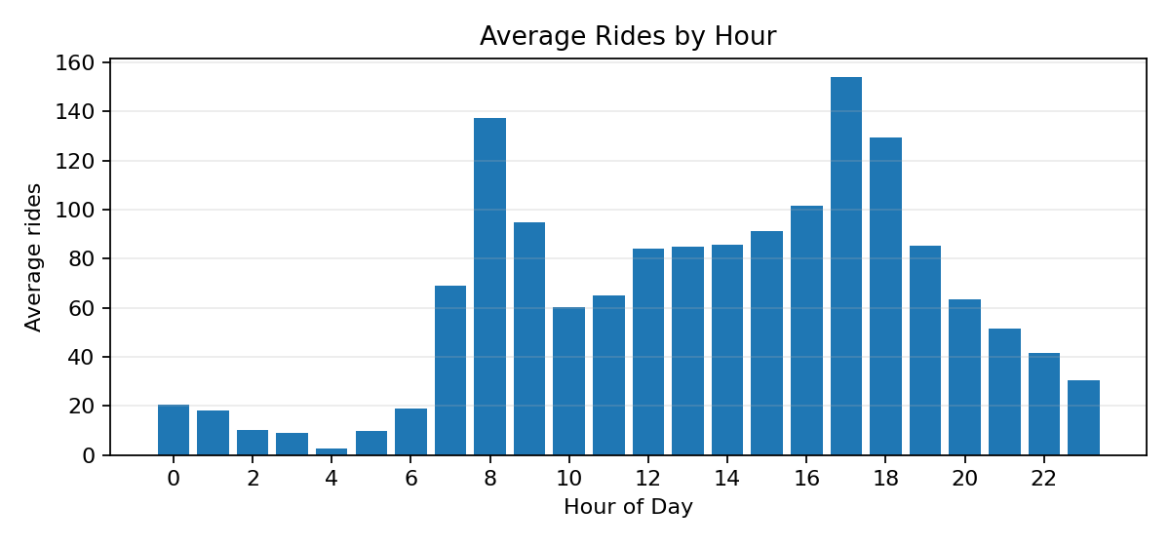
When is ride activity highest?
Average ride count by hour across available records
• Highest average hour: 17:00
• Average count at that hour: 154.1
• Hourly patterns can help distinguish commute periods from quieter hours
Source: supplied data excerpt | Slide 5

Slide 6
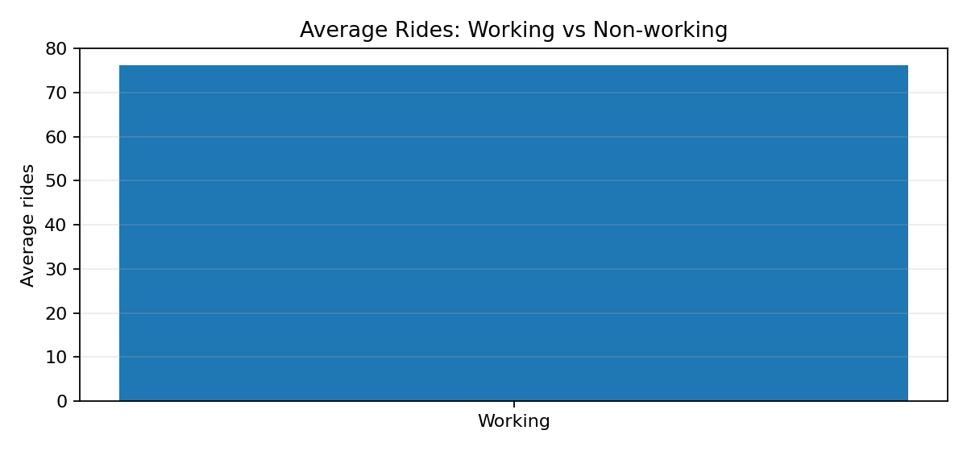
Working-day comparison
Workingday flag: 0 = non-working, 1 = working
• Non-working day average: nan rides per record
• Working day average: 76.3 rides per record
• Descriptive comparison only; it does not establish causation
Source: supplied data excerpt | Slide 6

Slide 7
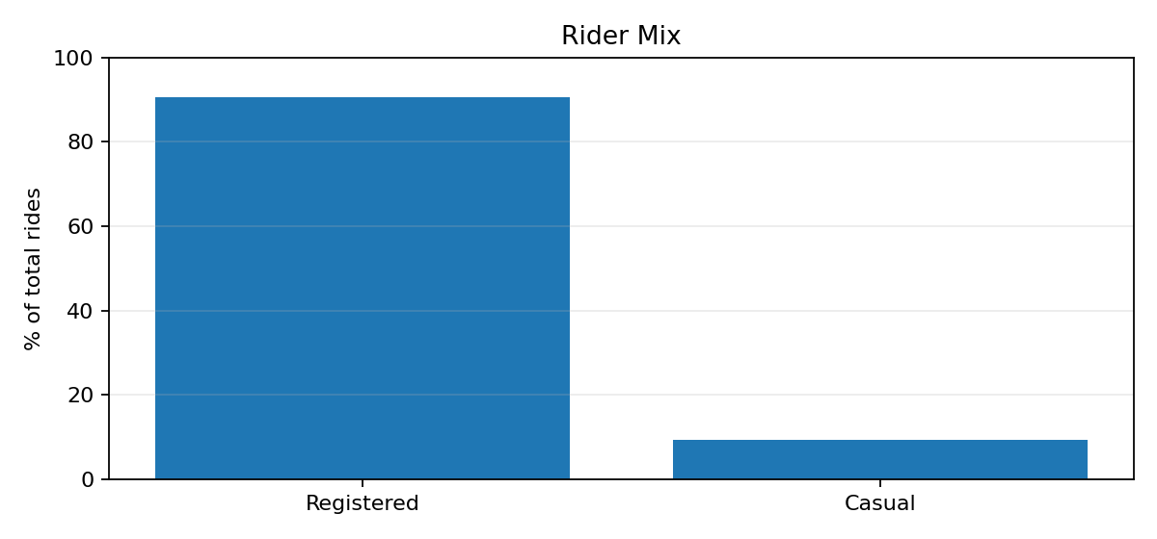
Who is using the bikes?
Share of total rides from the two rider categories
• Registered rides: 90.5%
• Casual rides: 9.5%
• Count reconciles to casual + registered in 307 of 307 rows
Source: supplied data excerpt | Slide 7

Slide 8
Temperature & humidity
Environmental variables available for further analysis
• Temperature values range from 0.06 to 0.42
• Humidity values range from 0.21 to 1.00
• Windspeed values range from 0.00 to 0.58
• This excerpt does not include a weather-category column; comparisons here are limited to the fields shown
Source: supplied data excerpt | Slide 8

Slide 9
Key takeaways & limitations
• The excerpt contains 307 hourly records across 18 dates.
• Peak average hour in this excerpt: 17:00.
• Registered riders account for 90.5% of the total ride count in the excerpt.
• Results describe only the supplied rows, not necessarily the full bike-sharing dataset.
• The source has no header row; verify inferred field names and definitions before operational use.
Source: supplied data excerpt | Slide 9

